Slide 1
AI PolicyChat
March 1st, 2024
Davis Craig, Abdul Rehman, Muhammad Asghar, Talia Qaiser, Hiba Hassan, Alex Yang, Grace Kim

Slide 2
Motivation
Prompt Engineering
Fine-tuning
Human Evaluation
Discussion/Future Work

Slide 3
Motivation
To learn and deploy a large language model that can understand, and answer questions related to AI policy.
To develop a chat environment that was fine-tuned and refined using prompt engineering techniques.
Process
Documents addressing AI policy were aggregated and question and answer (Q&A) pairs were constructed and formatted in JSON.
The topics regarding AI policy were collected from US and international governmental websites, policy think-tanks and research organizations, international organizations, and public policy forums and repositories.
This file was then used to train and fine-tune a Llama2-7b large language model.

Slide 4
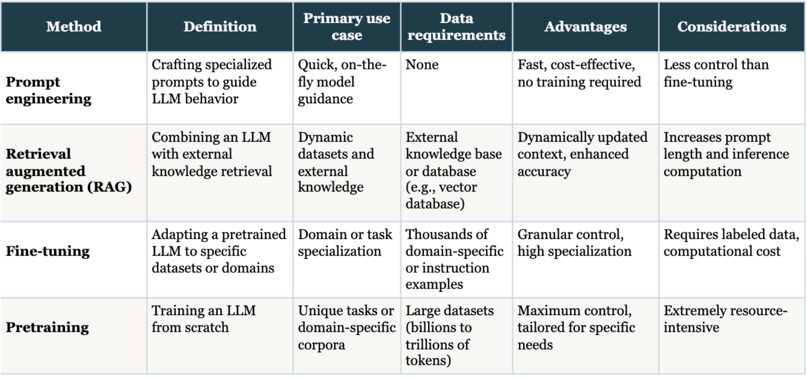
Methods

Slide 5
Prompt Engineering
Example outputs of a few prompting techniques

Slide 6
Prompt Engineering
Adaptation
Prompt Engineering
Fine Tuning
Evaluation (Human and Automatic)
Zero-Shot Prompting
One-Shot Prompting
Chain-of-thought prompting
General Knowledge Prompting
Prompt Chaining

Slide 7
Base Model: Zero-Shot Prompting
Task Description: Give a holistic AI policy for a problem when prompted. It should have some or all of the following components if relevant to the problem: 1. Ethical Principles, 2. Transparency and Explainability, 3. Fairness and Bias Mitigation, 4. Accountability and Responsibility, 5. Privacy Protection, 6. Security Measures, 7. User Consent and Control, 8. Data Governance, 9. Collaboration and Stakeholder Engagement, 10. Compliance with Regulations, 11. Robust Testing and Validation, 12. Human-in-the-Loop, 13. Continuous Improvement, 14. Emergency Protocols Prompt: What are the key steps in the development of an AI policy framework? Answer: The development of an AI policy framework involves several key steps: 1. Identifying the problem: The first step is to identify the problem or issue that the AI policy is intended to address. This may involve conducting a needs assessment to determine the specific challenges and concerns that the policy is intended to address. 2. Developing a vision: The next step is to develop a vision for the AI policy, which should outline the intended outcomes and goals of the policy. This vision should be based on the identified problem and should be aligned with the organization’s overall mission and values. 3. Conducting a stakeholder analysis: The third step is to conduct a stakeholder analysis to identify the key stakeholders who will be impacted by the policy. This analysis should involve identifying the different groups of stakeholders, such as employees, customers, partners, and regulators, and their respective interests and concerns. 4. Developing policy objectives: The next step is to develop policy objectives, which should be aligned with the vision and stakeholder analysis. These objectives should be specific, measurable, and achievable, and should be

Slide 8
Base Model: One-Shot Prompting
Task Description: Give me a comprehensive AI policy that prioritizes ethical considerations and meets stringent transparency, fairness, and accountability standards. Example: The AI development policy for governmental organizations prioritizes fairness, transparency, and accountability. All AI initiatives must undergo rigorous ethical assessments, ensuring alignment with human rights and privacy standards. Transparency measures include disclosing data sources and algorithmic processes. Accountability is ensured through regular audits and oversight mechanisms to address any ethical or fairness concerns. Prompt: Give me an AI development policy for a governmental organization. The AI development policy for governmental organizations prioritizes fairness, transparency, and accountability. All AI initiatives must undergo rigorous ethical assessments, ensuring alignment with human rights and privacy standards. Transparency measures include disclosing data sources and algorithmic processes. Accountability is ensured through regular audits and oversight mechanisms to address any ethical or fairness concerns. The policy also emphasizes the importance of diversity and inclusion in AI development, recognizing the potential for biases to arise from the use of data sets that are not representative of the population. To address this, the policy requires the use of diverse data sets and the involvement of diverse stakeholders in the development process. In addition, the policy emphasizes the importance of responsible AI, which involves ensuring that AI systems are designed to be transparent, explainable, and accountable. This includes the use of explainable AI models, which can help to identify and address potential biases in the system. The policy also recognizes the need for ongoing training and education for government employees and contractors involved in AI development, to ensure that they

Slide 9
Base Model: Chain-of-Thought Prompting
Question: How does a healthcare organization address privacy concerns and ensure compliance with healthcare regulations in the development and deployment of AI systems, especially in handling sensitive patient data? Answer: A healthcare organization can prioritize patient privacy and adhere to stringent data protection regulations throughout the development and deployment of AI systems. It can implement robust security measures to safeguard sensitive patient data. The AI policies explicitly should outline the procedures for data collection, storage, and processing, ensuring compliance with healthcare regulations. Regular audits and assessments should be conducted to monitor and enhance the security and privacy posture of AI systems, demonstrating the commitment to maintaining the highest standards in healthcare data management. Prompt: How does a financial institution ensure data security and regulatory compliance when implementing AI technologies, especially in handling sensitive financial information and transactions? Answer: A financial institution can prioritize data security and regulatory compliance when implementing AI technologies by adopting a risk-based approach to data protection. The AI policies should outline the procedures for data collection, storage, and processing, ensuring compliance with financial regulations. Regular audits and assessments should be conducted to monitor and enhance the security and privacy posture of AI systems, demonstrating the commitment to maintaining the highest standards in financial data management. Prompt: How does a retailer ensure data security and regulatory compliance when implementing AI technologies, especially in handling sensitive customer information and transactions? Answer: A retailer can prioritize data security and regulatory compliance when implementing AI technologies by adopting a risk-based approach to data protection. The AI policies should outline the procedures for data collection, storage, and processing, ensuring compliance with retail regulations. Regular audits and assessments should be conducted to monitor and enhance the security and privacy posture of AI systems, demonstrating the commitment to maintaining the highest standards in retail data management. Prompt: How

Slide 10
Fine Tuning
Adapting a pre-trained language model to a specific task, tone, or domain

Slide 11
Fine-Tuning
Adaptation
Prompt Engineering
Fine Tuning
Human Evaluation
Adapting a pre-trained language model to a specific task, tone, or domain
Notes:
PEFT is great for fine tuning a small amount of data and allows it to be generalized for other scenarios. LoRA is adding extra weights and modifying those, freezing the original weights.

Slide 12
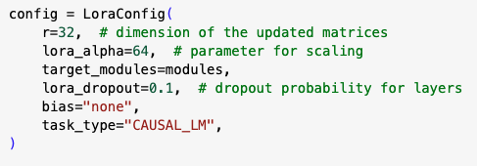
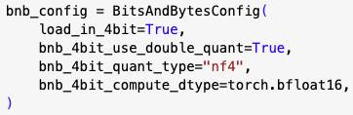
Fine-Tuning Configuration
We used QLoRA Tuning (4-bit quant size)
Notes:
The advantage then of using QLoRA is to be memory efficient. Only the base model is quantized and there is our configuration for LoRA and bits and bytes. We know we’re using QLoRA because the weights are in floating point 16.
CAUSAL_LM = predicting the following token based on a sequence of tokens.

Slide 13
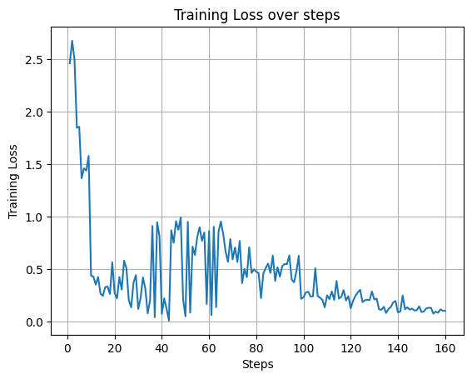
Fine-Tuning Training Loss
Key Training Parameters:
Batch Size: 1
Learning Rate: 2e-4
Epochs: 5

Slide 14

Fine-Tuning Process
Outputs
Pre - Trained Weights
B
A
Inputs

Slide 15
Fine Tuned Output
Example outputs of a few prompting techniques from the Fine Tuned Model

Slide 16
Example Outputs: One-Shot
What kind of consumer data protection policies should an online retail organization consider?
Considering the potential harms to consumers, online retail organizations should adopt policies that safeguard consumer privacy and security. This includes practices like transparent data collection, user consent, and the right to opt-out of targeted advertising and the sale of personal information. Additionally, organizations should employ industry-recognized security measures to protect consumer data, such as encryption and multi-factor authentication.
Organizations should adopt policies that ensure data privacy and security for consumers, including practices such as limiting the collection of sensitive information, providing clear notice and opt-out options for data sharing, implementing appropriate security measures to protect consumer data, and complying with applicable laws and regulations. Additionally, organizations may consider adopting policies that encourage responsible AI use, such as evaluating and auditing AI systems for potential biases, providing explanations for automated decisions, and giving customers the option to interact with a human in high-impact situations.
base
fine-tuned

Slide 17
Example Outputs: Chain-of-Thought
How does a financial institution ensure data security and regulatory compliance when implementing AI technologies, especially in handling sensitive financial information and transactions?
A financial institution can prioritize data security and regulatory compliance when implementing AI technologies by adopting a risk-based approach to data protection. The AI policies should outline the procedures for data collection, storage, and processing, ensuring compliance with financial regulations. Regular audits and assessments should be conducted to monitor and enhance the security and privacy posture of AI systems, demonstrating the commitment to maintaining the highest standards in financial data management.
A financial institution can adopt robust cybersecurity measures, including encryption, multi-factor authentication, and regular security audits, to safeguard sensitive financial information and transactions. It can also stay up-to-date with regulatory requirements, such as the Gramm-Leach-Bliley Act (GLBA) and the Payment Card Industry Data Security Standard (PCI DSS), to ensure compliance with federal and industry standards. By prioritizing data security and regulatory compliance, a financial institution can effectively leverage AI technologies while mitigating risks and maintaining trust with customers and regulatory bodies.
base
fine-tuned

Slide 18
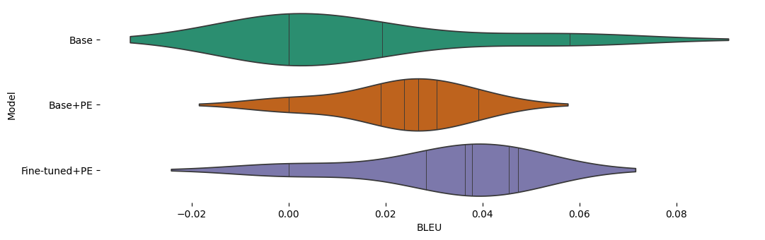
Automatic Metrics

Slide 19
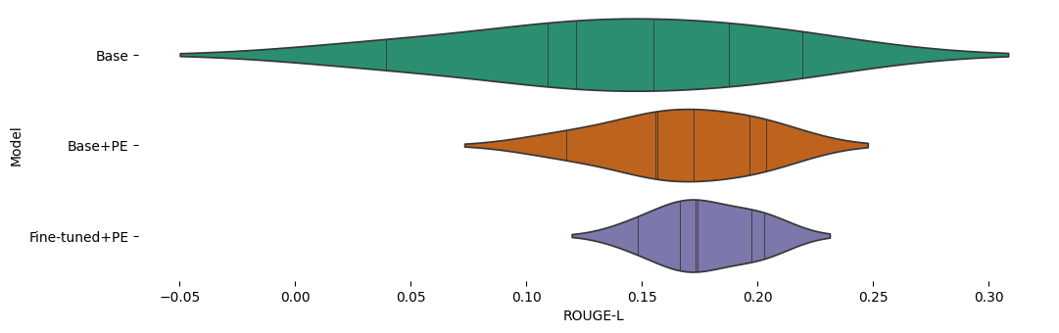
Automatic Metrics

Slide 20
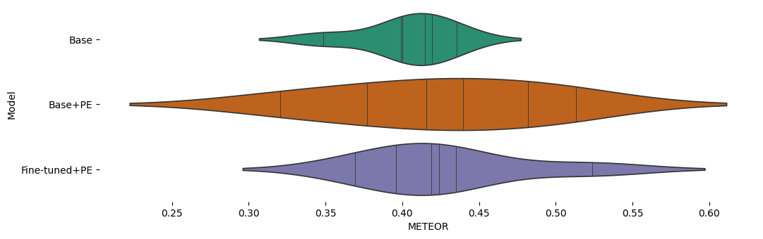
Automatic Metrics

Slide 21
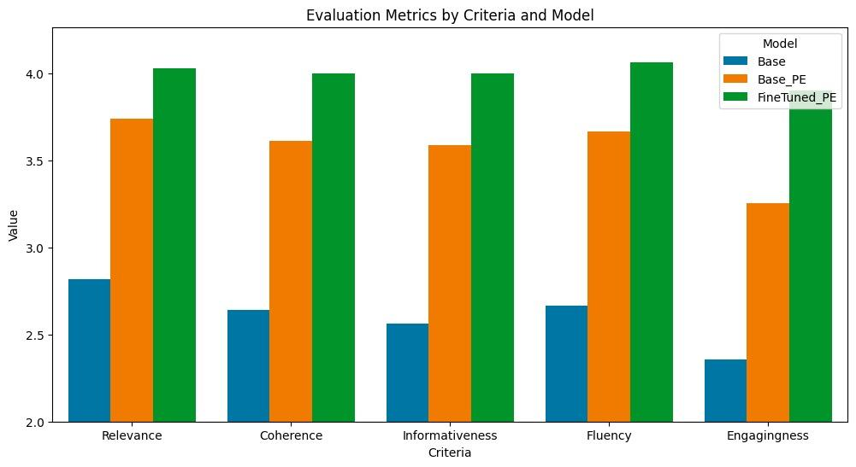
Human Evaluation
From a total of 38 evaluation feedbacks:

Slide 22
Discussion/Future Work

Slide 23
Discussion/Future Work
Should learn how to tell the model when to stop generating
Model may generalize better if trained on policy context
Perhaps increase the size of input training text
Should do instruction fine-tuning if compute allows
Hyperparameter tuning
Notes:
Davis: For fine-tuning:
- With more compute we could do instruction finetuning e.g. with Databricks 15k dataset. This would have enabled our model to respond more effectively to different prompting strategies
- For Policy Chat Q & A having the context in addition to the Q & A would be useful, make it more generalizable for any type of Q & A with context
- Also need to learn about how to finetune when to end the response (gets stuck in loop with our ### End token)
- Maybe tuning the number of epochs trained

Slide 24
Thank You!
Questions?

